Slide 1
Lab 16. Use decoder to control Display

Slide 2
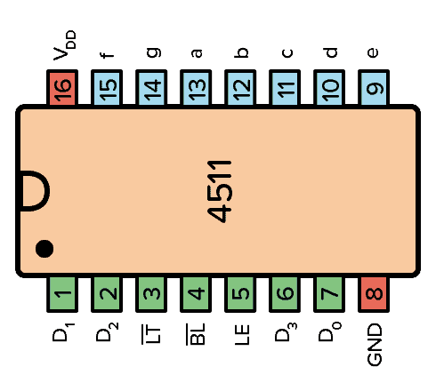
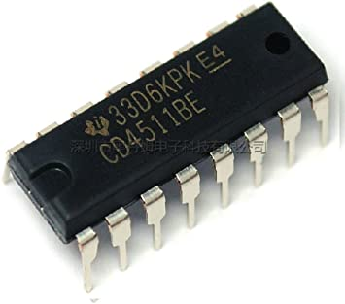
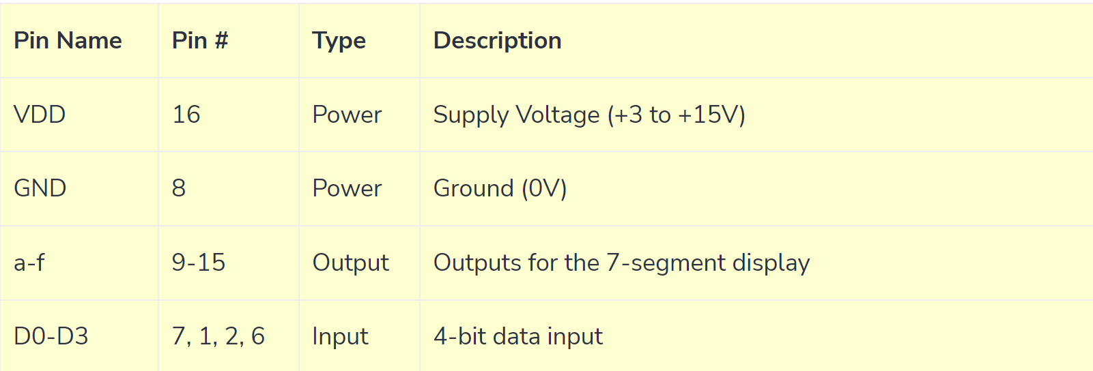
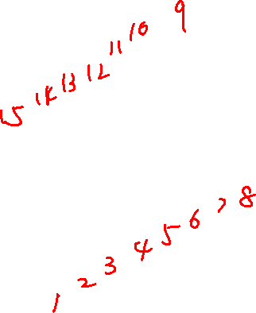
4511 IC

Slide 3
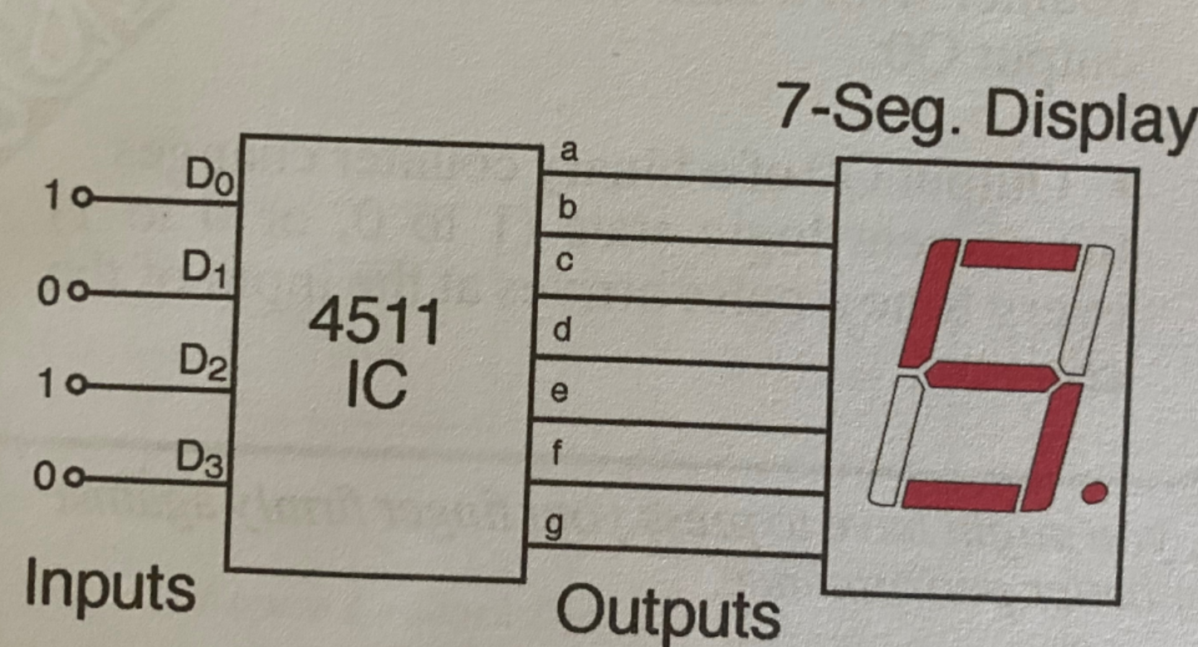
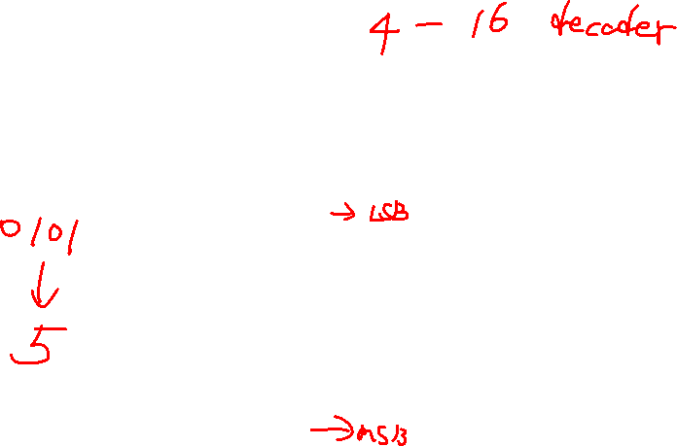

Slide 4
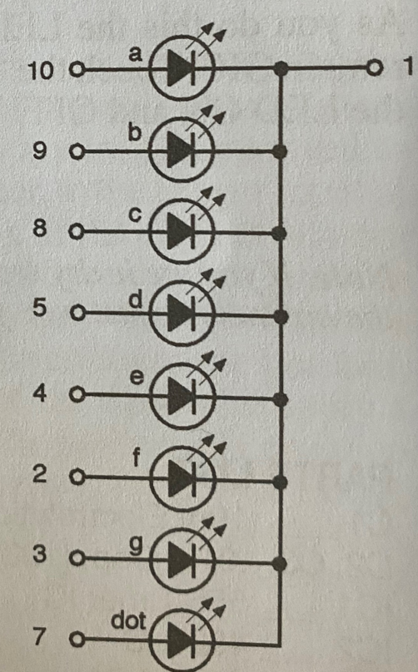
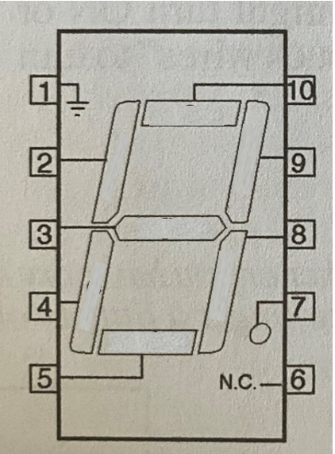
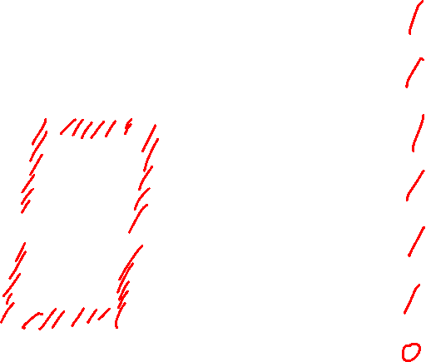
7 segment display

Slide 5
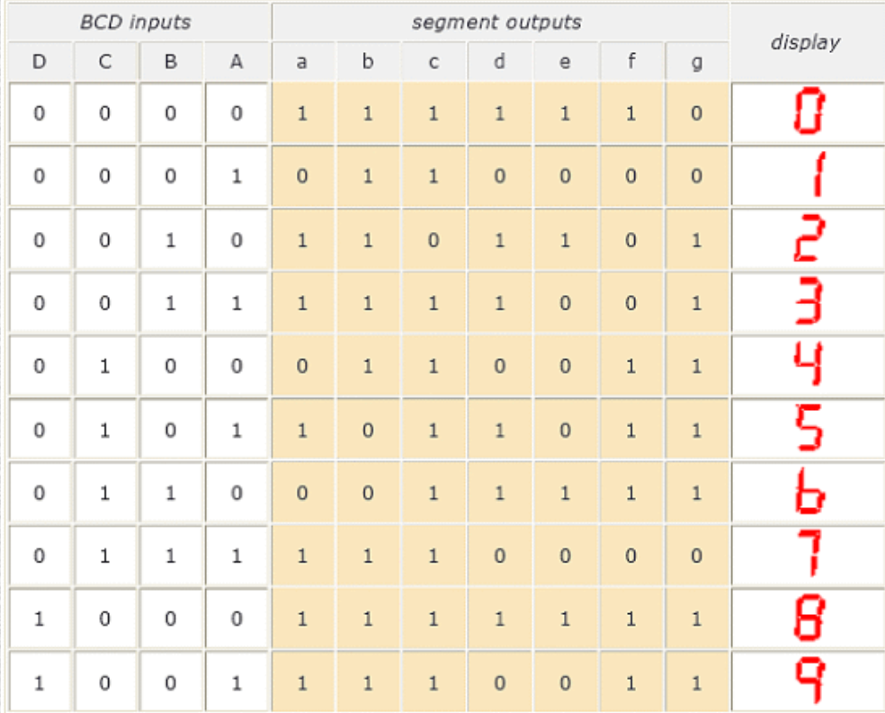
Determine how to connect IC with display

Slide 6
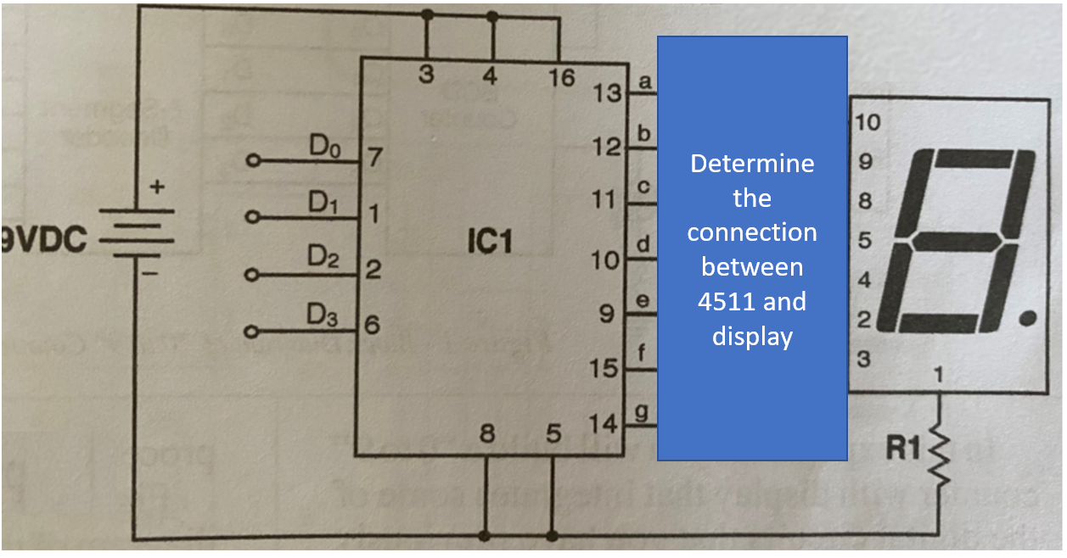

Pin 6 and 7 of display are not used for this lab.

Slide 7
Components
IC 4511 IC
R1 220Ωresistor(red,red,brown)

Slide 8
Requirements
First, write down the way to connect 4511 with display and show it to me
Use four wire to connect to 4 input of the 4511. Show me when the input is 0110 what is shown on the display

